Slide 1
Northwind Traders – Data Analytics & Visualization
Sales Insights from 2021–2023
Date: 07/08/2025

Slide 2

Executive Summary:
93% of 2023 revenue came from repeat customers, highlighting strong loyalty but weak acquisition.
High-AOV customers are under-engaged, representing a missed revenue opportunity.
Beverages and Dairy dominate sales, though profitability remains unclear.
Sales peak from May to August, revealing a seasonal opportunity.
Regional preferences vary significantly, suggesting localization strategies.

Slide 3
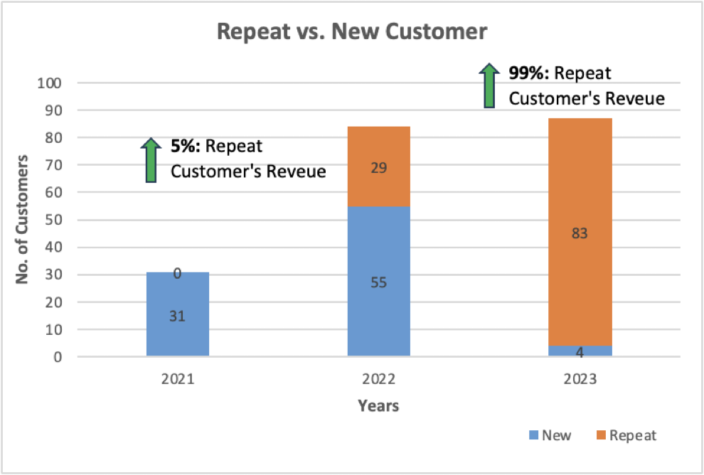
Repeat vs. New Customers:
Customer Loyalty Grows, Acquisition Shrinks
Revenue share by repeat vs. new customers
Acquisition dropped 93% from 2021 to 2023

Slide 4
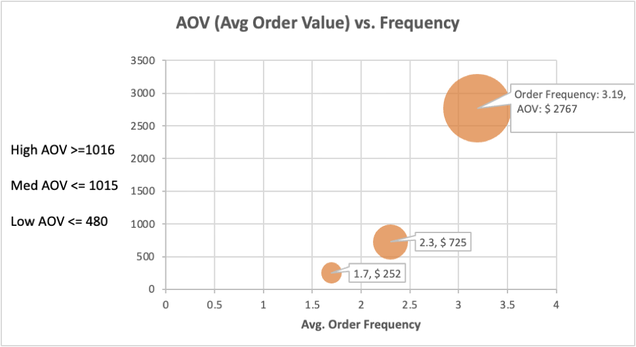
AOV vs. Frequency
High Spenders Are Buying Less Frequently
High-AOV customers (~50%) spend big but order rarely
Opportunity to increase frequency.

Slide 5
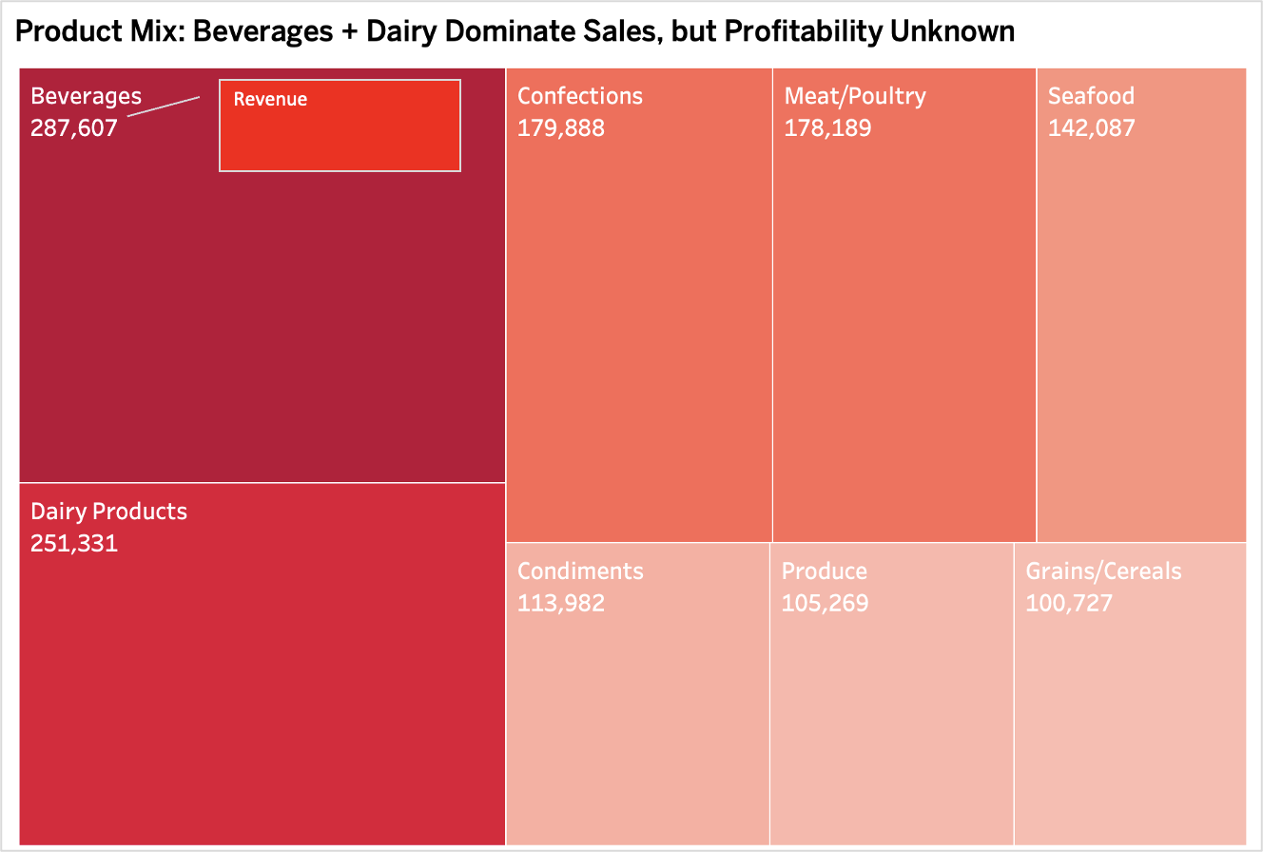
Product Mix – Beverages & Dairy
Concentration in Beverages and Dairy
Beverages & Dairy lead sales, but cost data is missing — so profitability is unknown

Slide 6
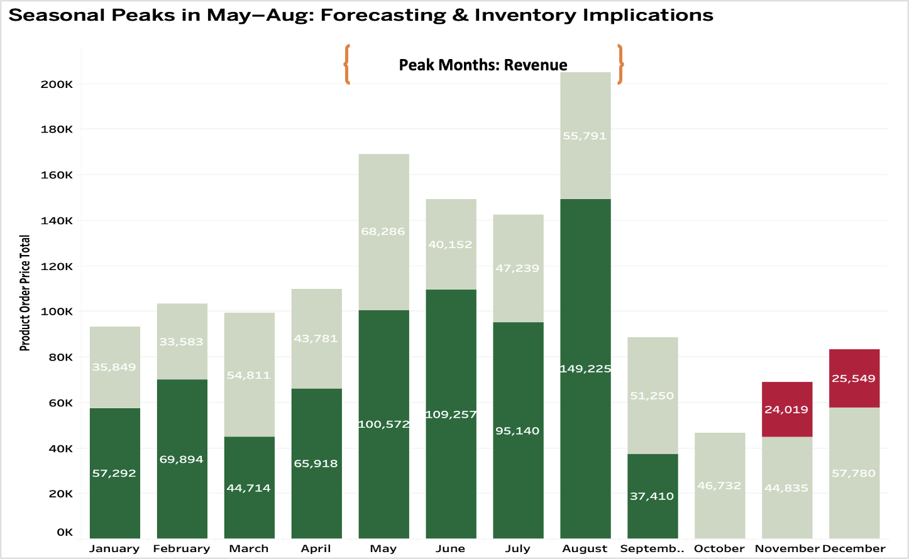
Seasonal Trends
Sales Spike in Summer Months
Consider using these months for promotions or new launches

Slide 7
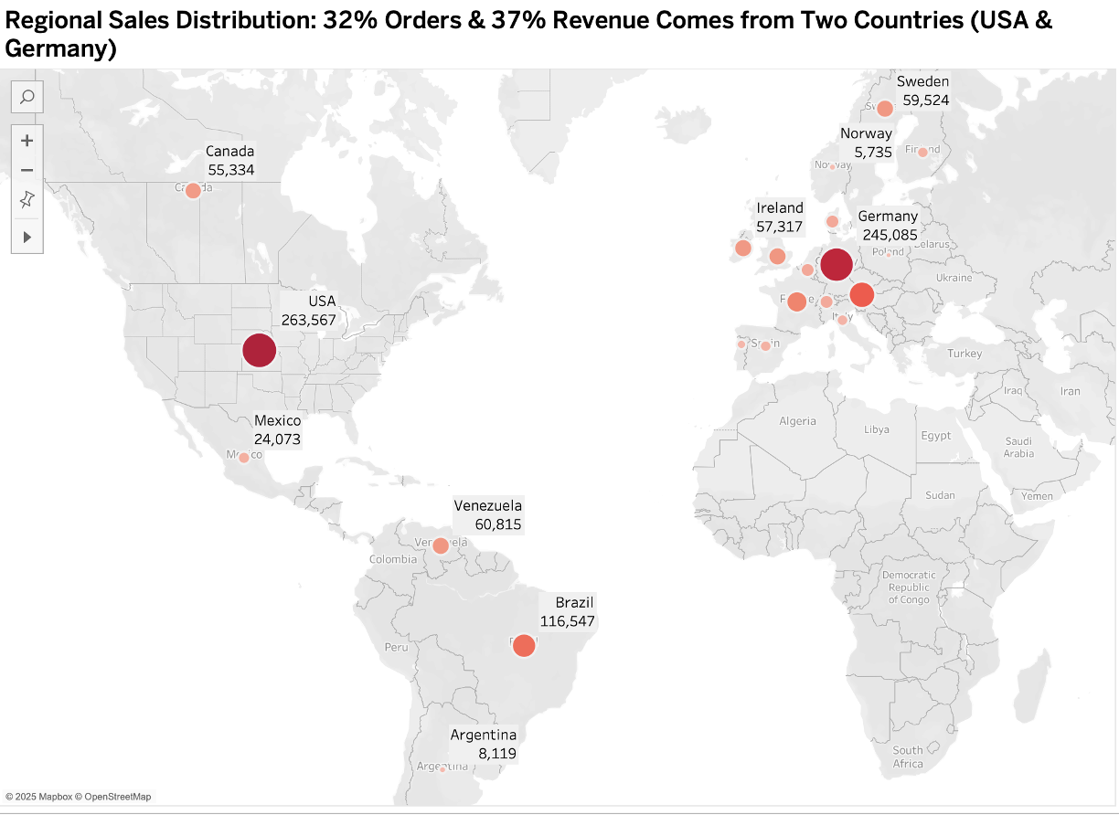
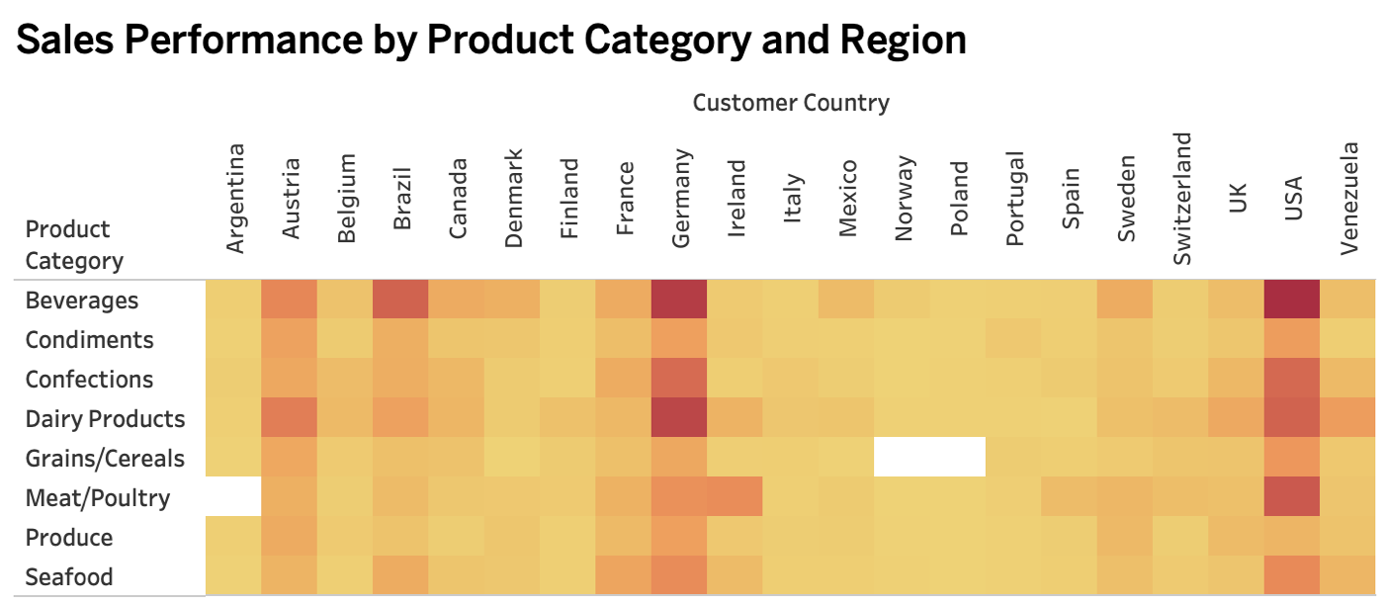
Sales by Region & Category
Regional Preferences Vary by Product
Localization potential exists for sales and marketing strategies

Slide 8
Recommendations – Customers
Customer Strategy Recommendations
Engage high-AOV customers with loyalty campaigns and bundles.
Revive new customer acquisition via digital marketing.
Understand churn and refine the funnel.

Slide 9
Recommendations – Operations
Operational & Profitability Recommendations
Implement Activity-Based Costing (ABC) to clarify product margins.
Localize product offerings by region.
Analyze seasonal category trends.

Slide 10
Final Takeaways & Next Steps
Strategic Takeaways & Next Steps
Invest in both retention and acquisition.
Use ABC to prioritize profit, not just volume.
Tailor marketing and inventory by season and region.

